Slide 2
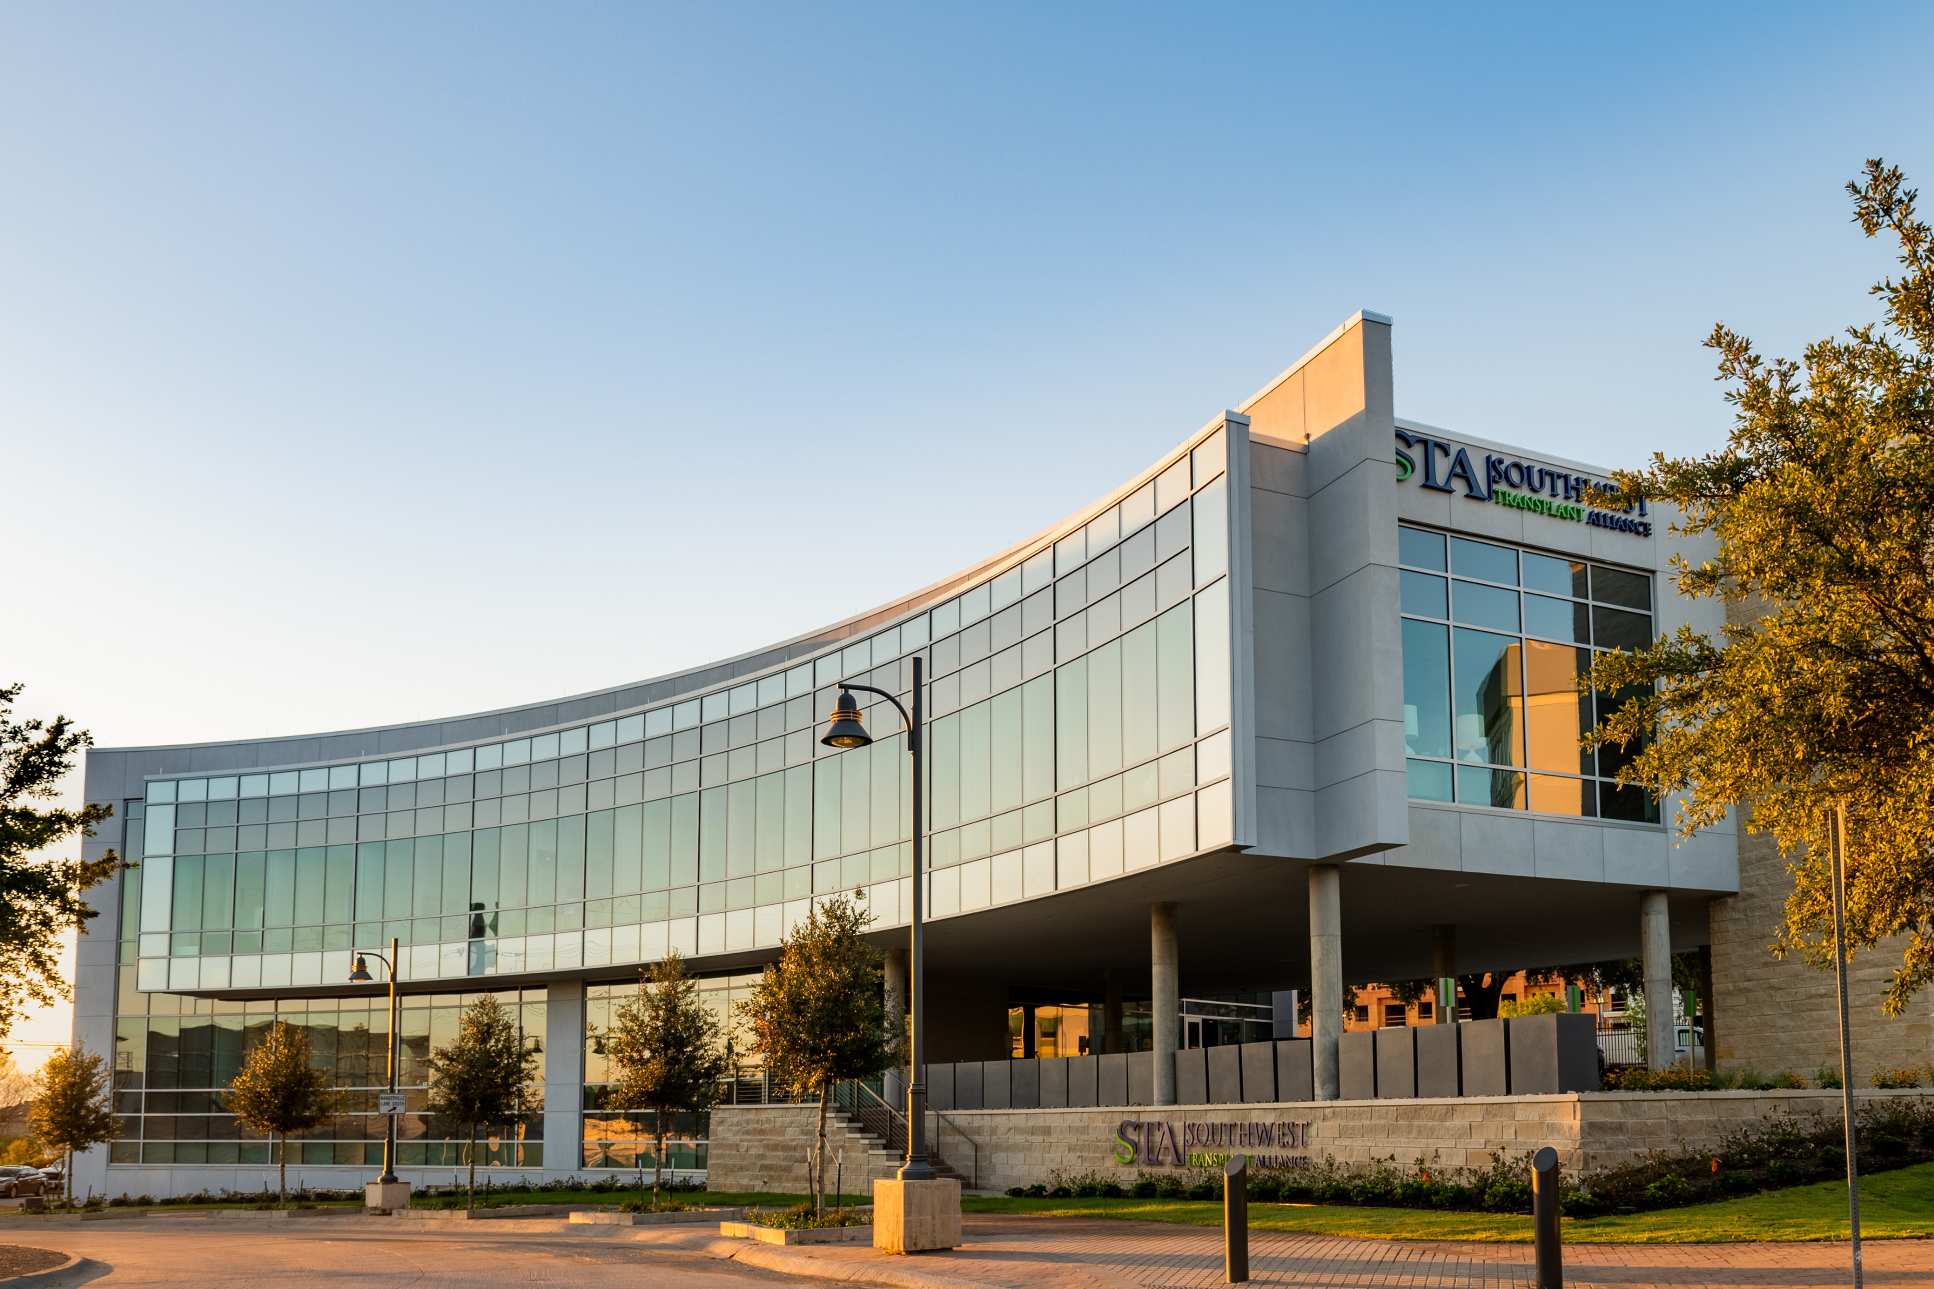
Who We Are
Southwest Transplant Alliance is a nonprofit organ procurement organization that saves lives by fulfilling the gifts of organ and tissue donation.

Slide 3
What We Do
Save lives through the gift of donation
For 50 years, STA has helped save and improve lives by recovering donated organs and tissue for transplantation.
Support donors and their families
We provide compassionate care and support to the courageous donor families navigating the loss of a loved one through grief support programs, community events, and more.
Lead the transplant industry
STA is at the forefront innovation, operational excellence, research, and finding new ways to save lives through organ and tissue donation.
Educate the community
We serve 89-county area across Texas. Our relationships & education efforts with community members and healthcare partners are invaluable to our lifesaving mission.

Slide 4
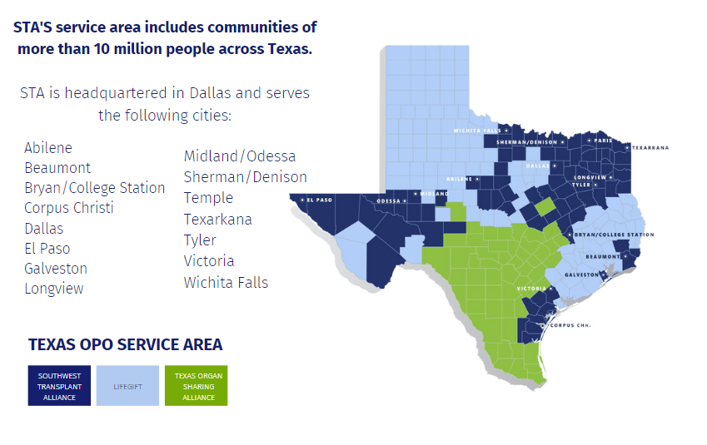
Who We Serve

Slide 5
The Donation Process

Slide 6
Why Donation Matters
There are more than 100,000 people awaiting a lifesaving transplant in the United States …including over 10,000 in Texas.

Slide 7
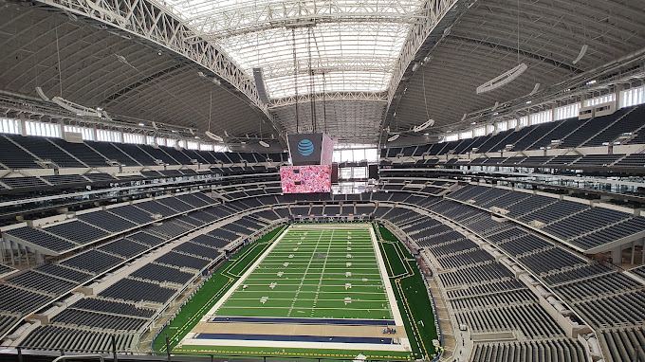
Notes:
The Cowboys stadium can only hold 80,000

Slide 8
The Waiting List
On average, 17 people die each day because the organ
they need is not available.

Slide 9
The Waiting List
And every 9 minutes*, someone is added to the waiting list.

Slide 10
Shante
Waiting List Patient

Slide 11
Did you know? Organ Donation is RARE
Less than 1% of deaths occur in a manner that allows for organ donation.
Why?
Patients must be in a hospital, on a ventilator, and meet other criteria for organ donation to even be considered as an option.

Slide 12
Types of Organ Donation
Living Donation
Coordinated directly by transplant centers, not recovery organizations/OPOs
Deceased Donation
Recovered and coordinated by OPOs
Notes:
kidney, a piece of your liver and other tissue

Slide 13
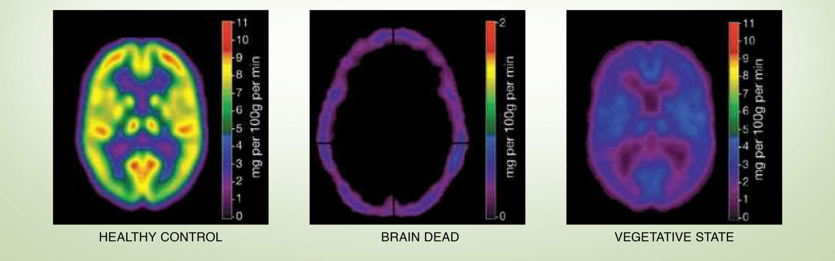
Brain Death vs. Coma
What is the difference in a coma and brain death?
Brain death occurs when:
All brain tissue is dead
No electrical activity in the brain
No blood flow
A coma occurs when:
A portion of the brain is injured
Electrical activity is present in the brain
There is blood flow
Brain death is the complete, irreversible cessation of all brain function.
A person cannot recover from brain death.

Slide 14
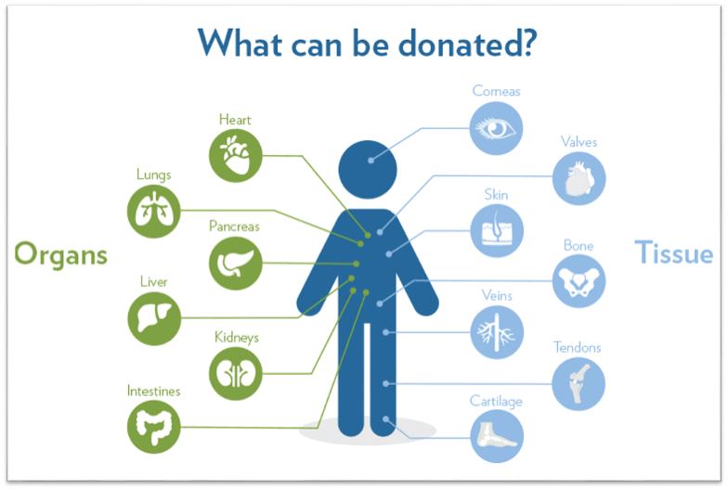
The Power of One
One heroic donor has the power to save 8 lives through organ donation
& heal 75 more through tissue donation.

Slide 15
Jordan Santiago
Donor Hero

Slide 16
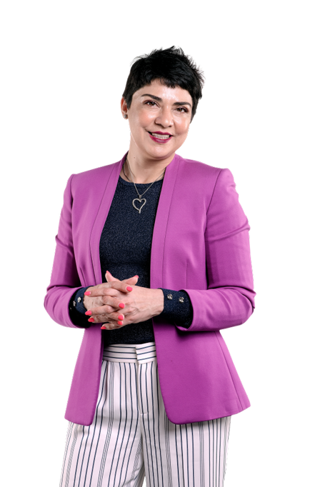
Learn the Facts
Sadly, many people do not register due to myths/misconceptions about organ donation.
Which have you heard?

Slide 17
Myth: Doctors will let me die so they can take my organs.
Fact: Your life comes first.
First responders and medical professionals will always make every effort to save a patient's life, regardless of donor status. Donation is only considered as an option after all lifesaving efforts have been exhausted.

Slide 18
Myth: Donation is against my religion.
Fact: Nearly all major religions
support donation.
Most major religions in the U.S. support or encourage donation as a final act of love and kindness.

Slide 19
Myth: Once I register, I don't need to tell my family.
Fact: Share your donation decision.
Registering as a donor is an important step, and we also encourage you to share that decision with loved ones. You might even inspire them to register too!

Slide 20
What are my next steps?

Slide 21
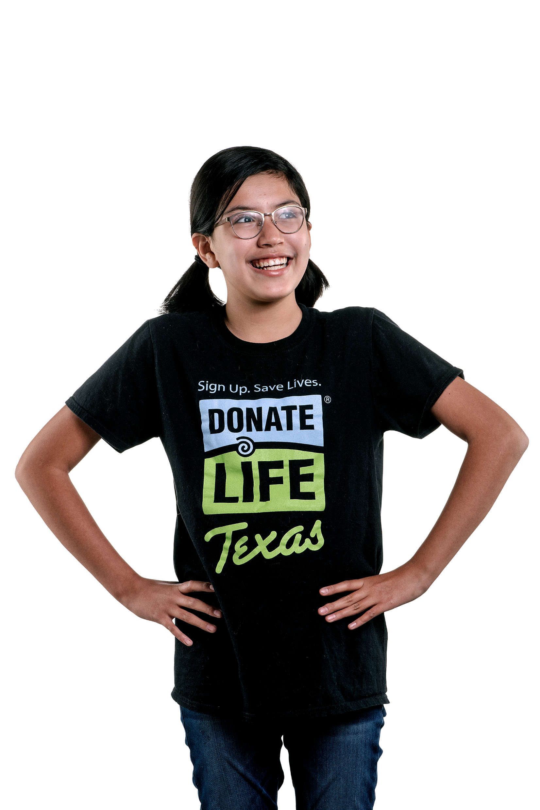
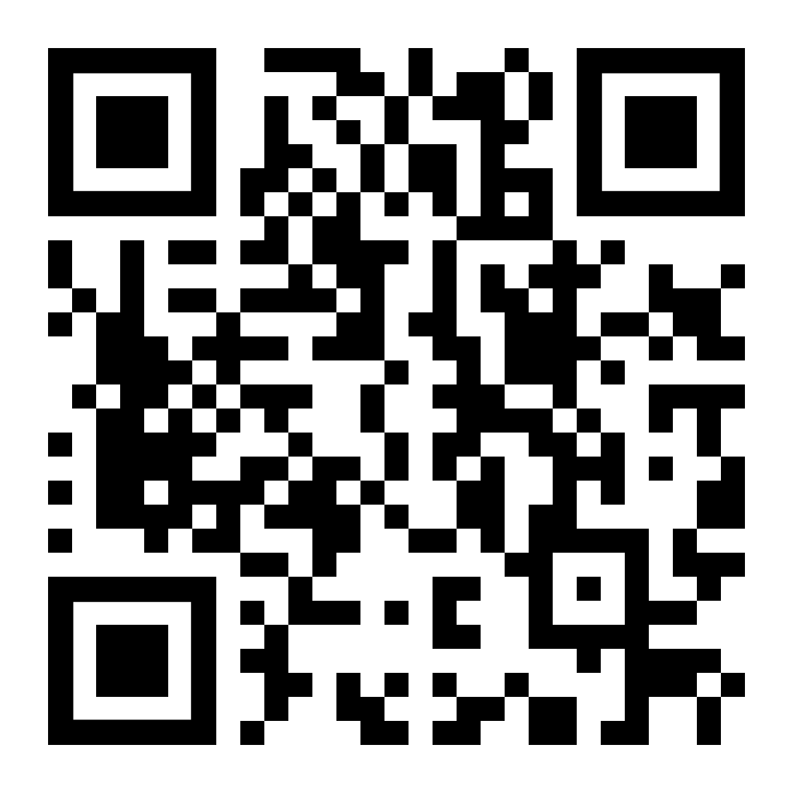
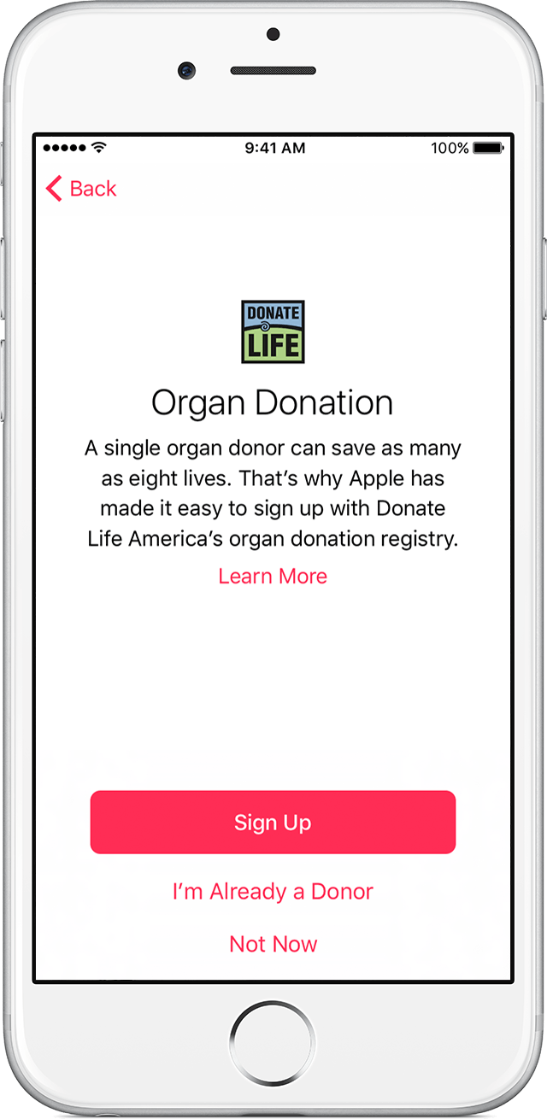
Register Your Decision!
Online Now! Organ.org | Organ.org/espanol
Department of Public Safety
Check “YES” when you apply for or renew your driver’s license/ID card/vehicle registration
Texas Parks and Wildlife Check the box on your hunting or fishing license
iPhone Health App Visit the Medical ID tab or ask Siri if she's a registered organ donor

Slide 22
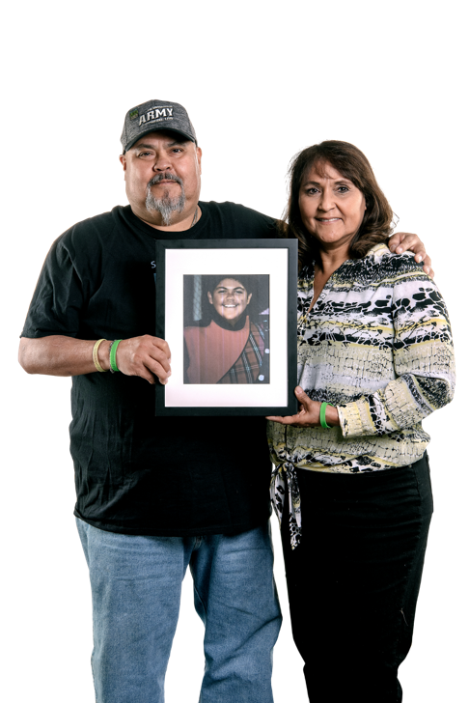
Share Your Decision
You've learned all about the FACTS of donation today – share what you've learned and your decision with loved ones!

Slide 23
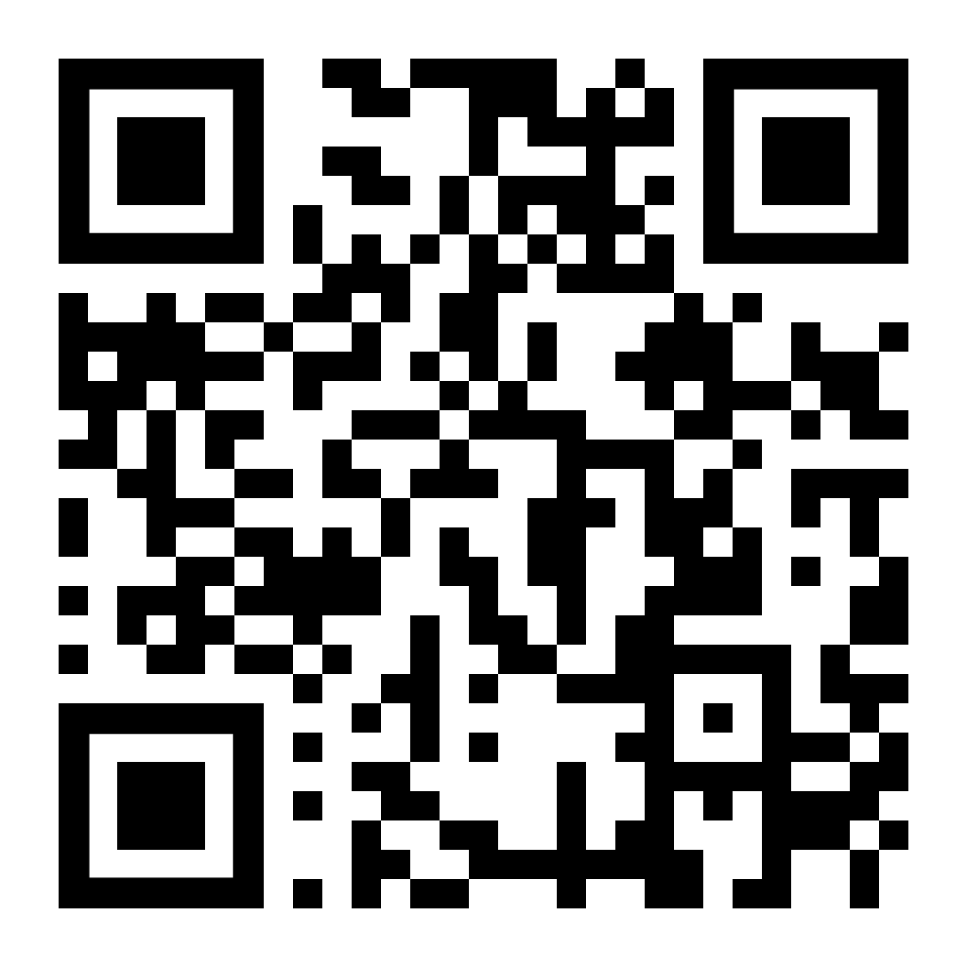
Become An Advocate
Join the STA Volunteer Program
and spread the mission of donation
through community events, donation
drives, and more!

Slide 24
Make a Contribution
Support for STA Foundation helps to care for donor and recipient families, inspire the community to honor the gift of life, and foster initiatives that advance transplant science.

Slide 25
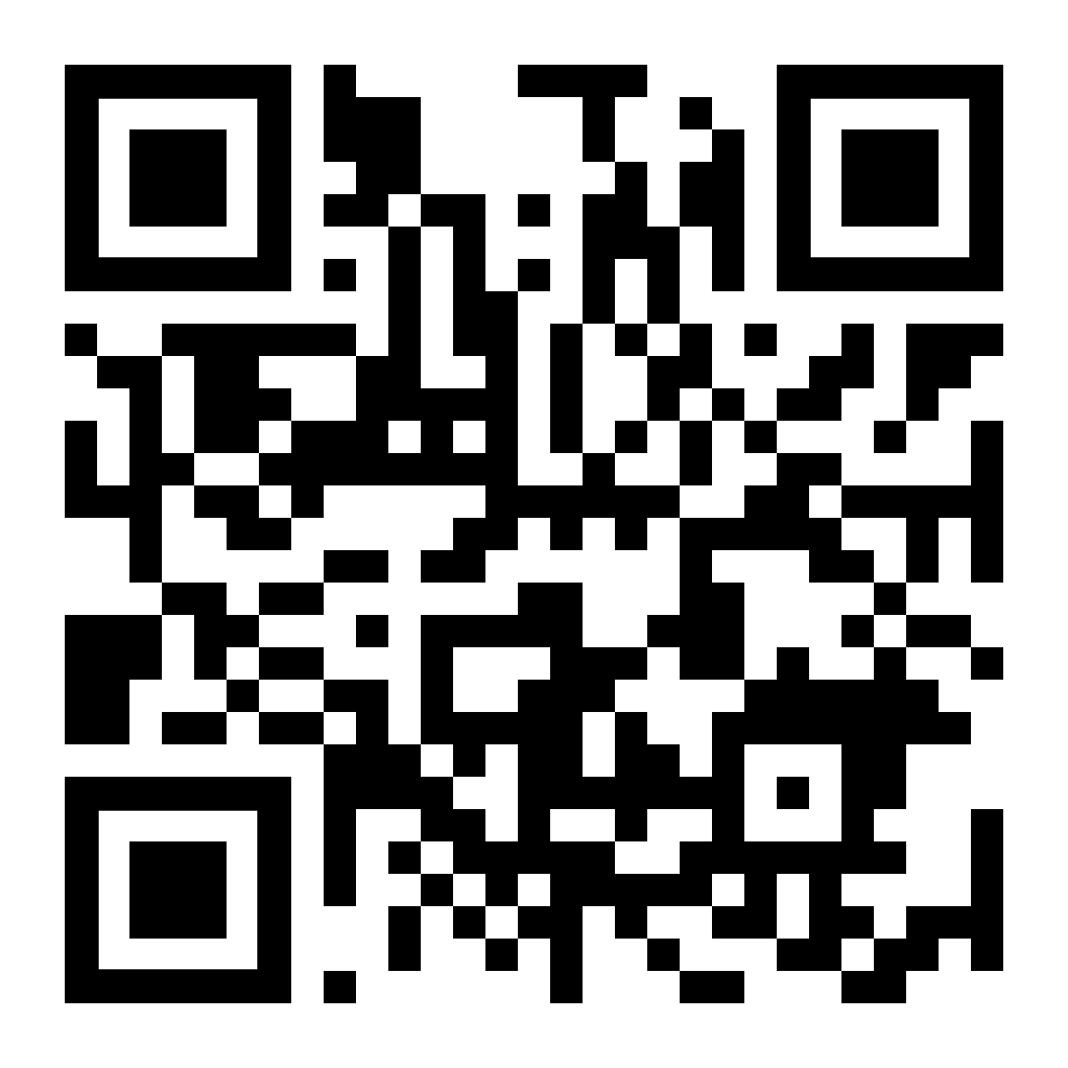
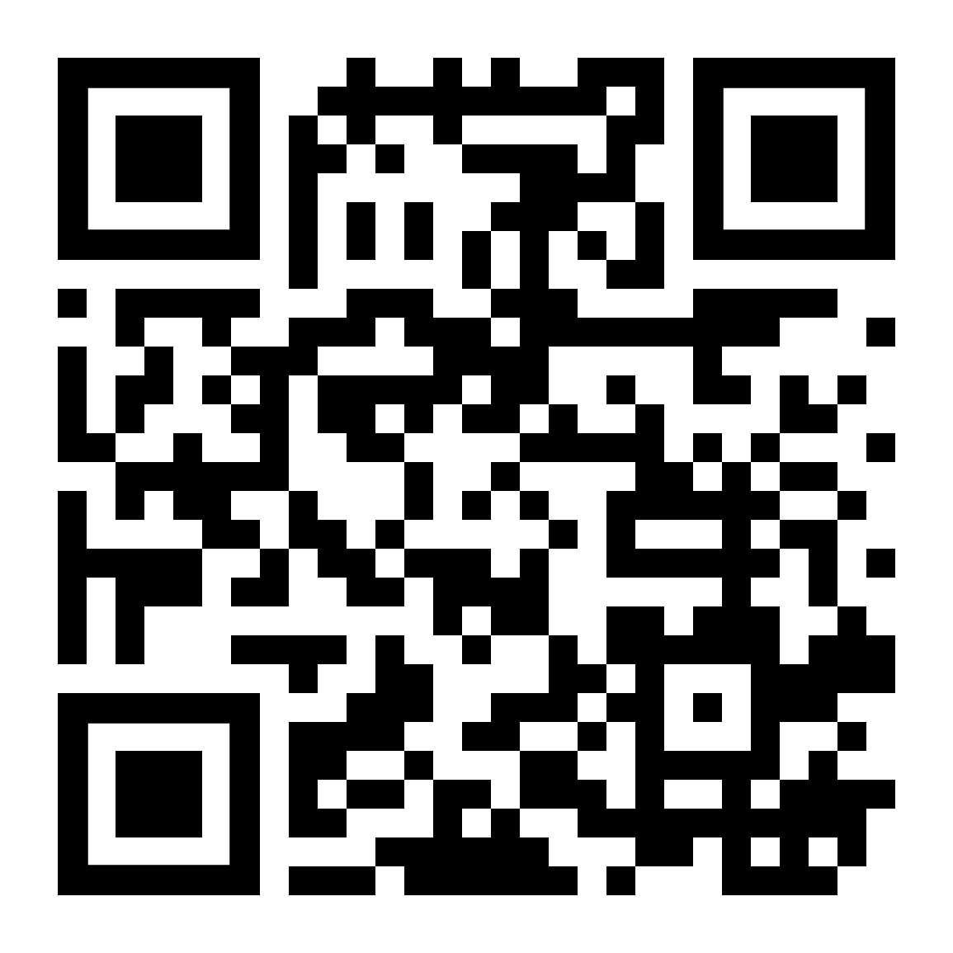
Stay Connected
Upcoming Events
organ.org/upcomingevents
Community News
organ.org/communitynews

Slide 26
Thank you!
To learn more,
please visit
organ.org

